Slide 1
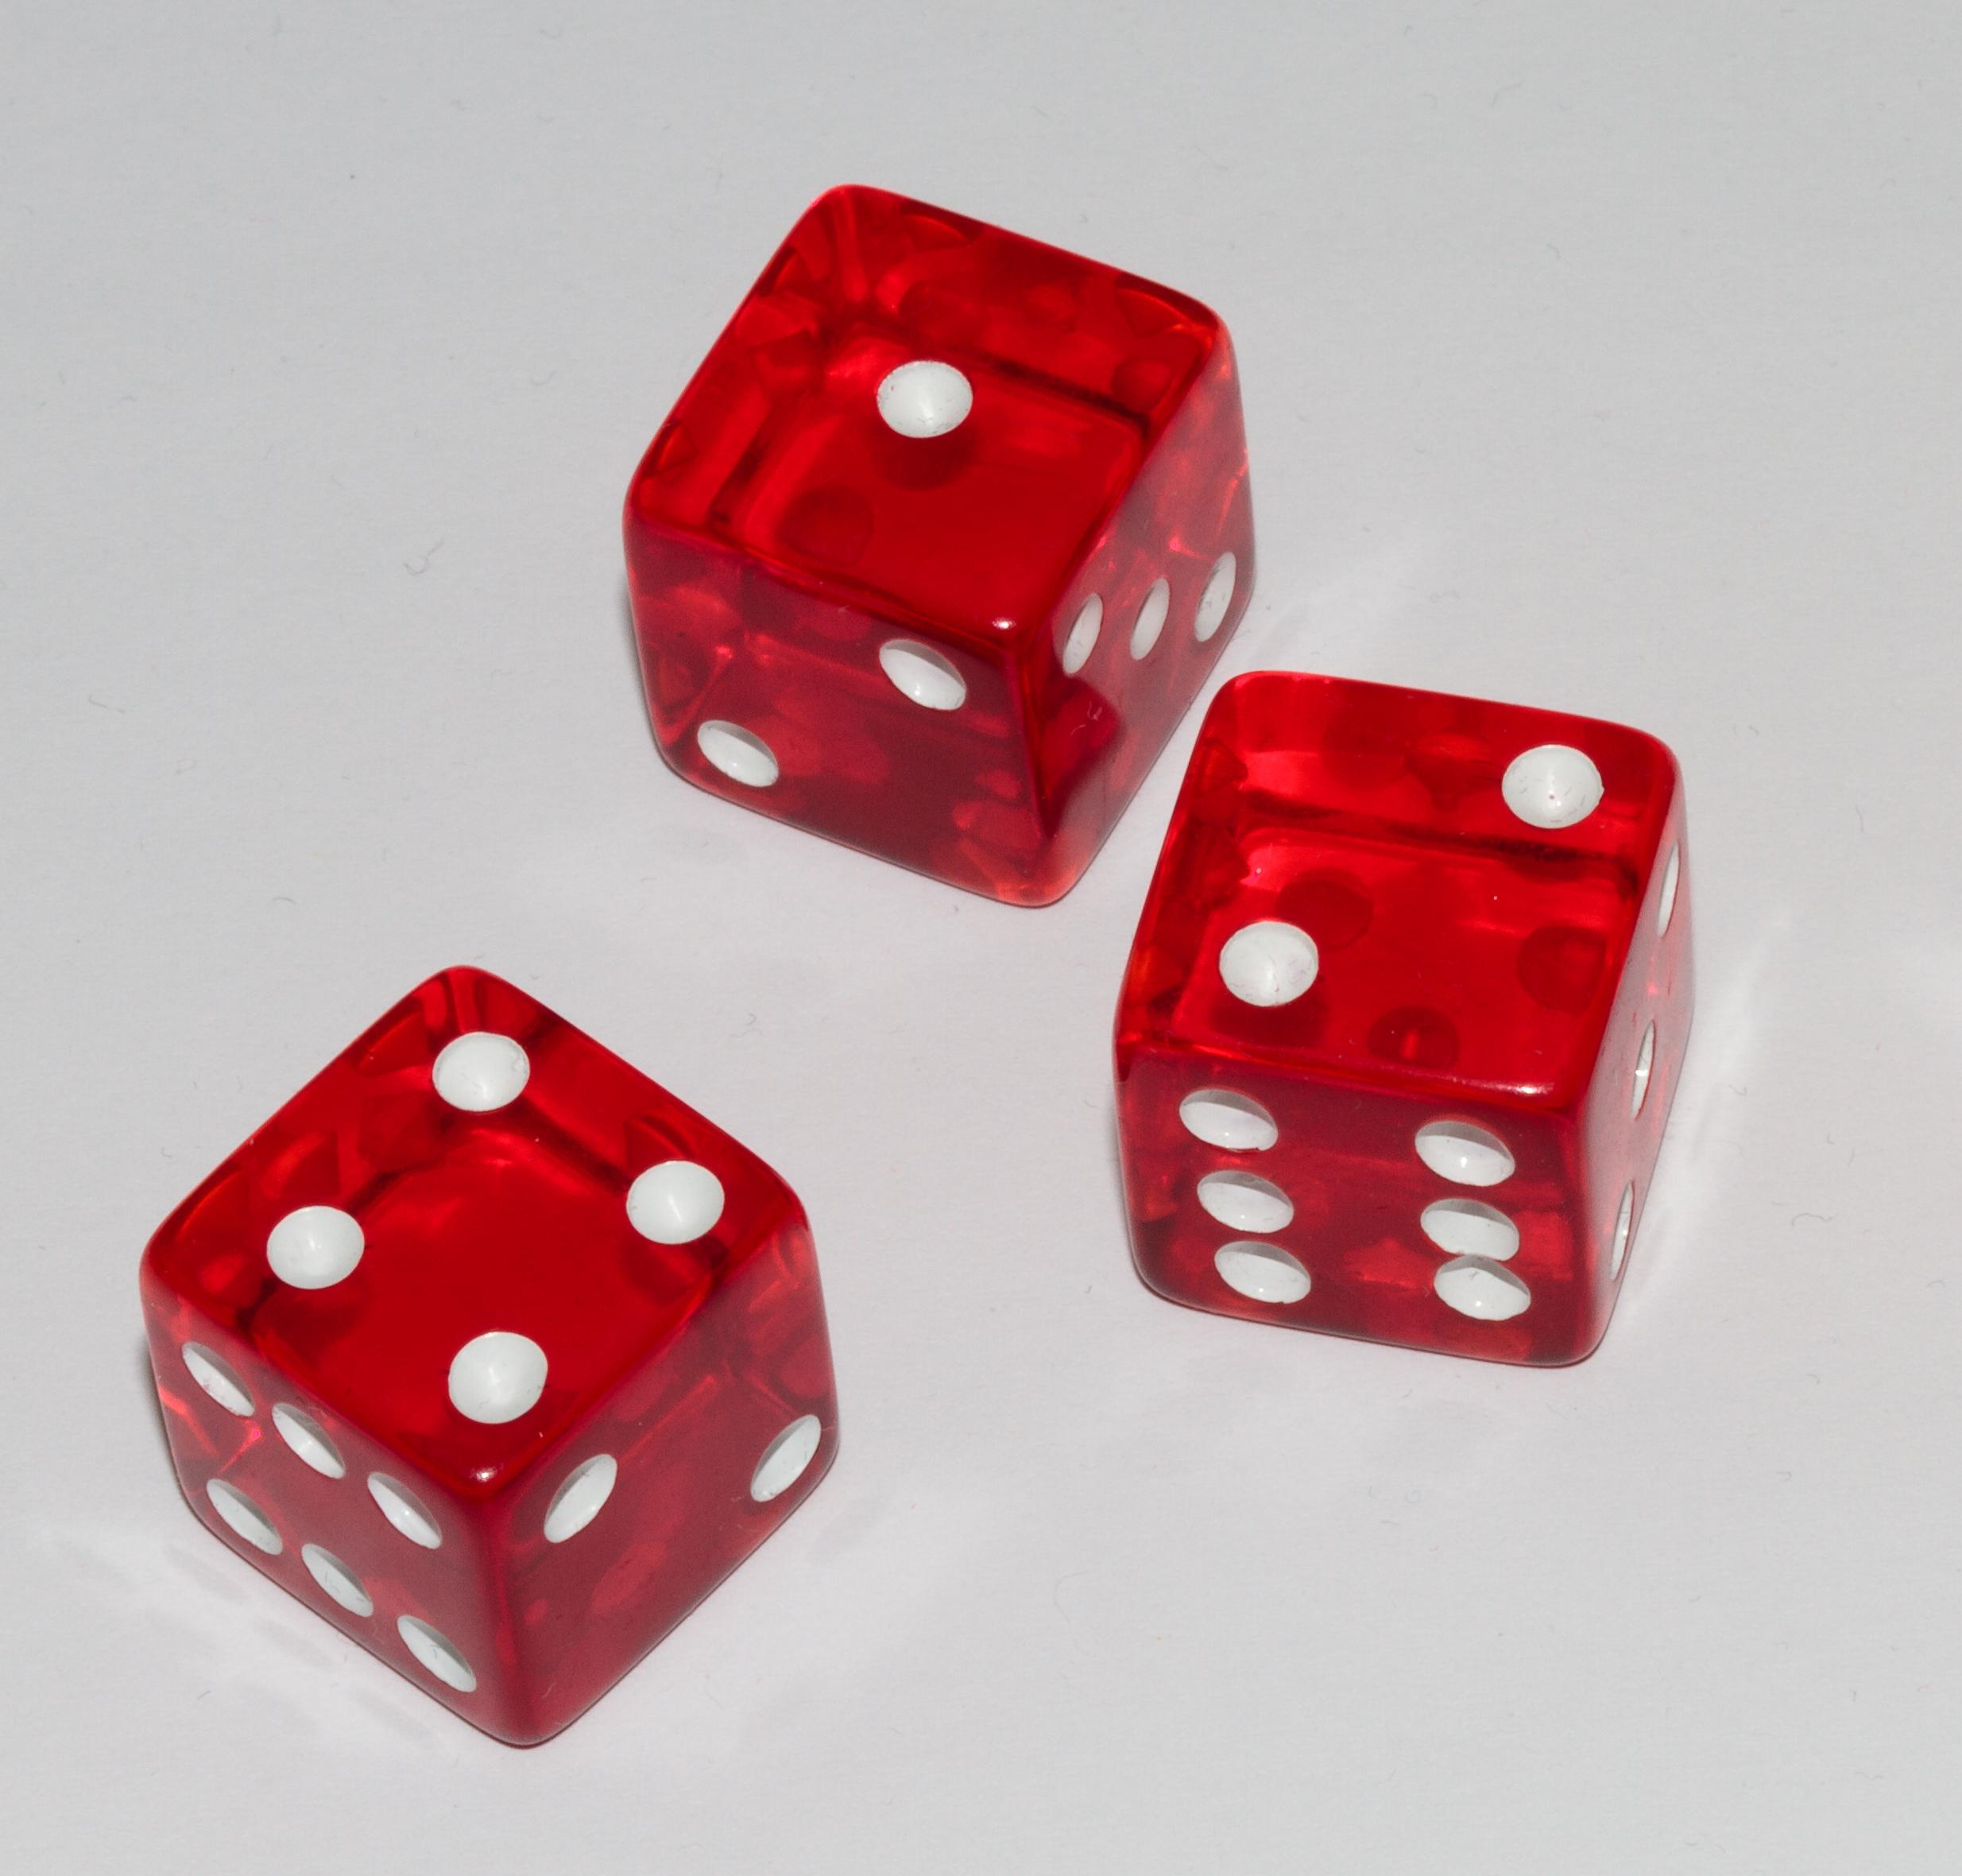
Welcome to CS149 Students to….
THE FOURTH HOUR
TOPIC - Intro to Objects
Notes:
While students are filtering in, circulate a piece of paper for students to write their names on. Include a place for name and professor. If a student came in late, note what time they came in so that we can accurately track data. (The observing TA should probably be the one to manage and record when a student comes in late)

Slide 2

Introductions
Name
Professor
Fun Fact About yourself

Slide 3
What are objects?
Object-oriented programming allows us to encapsulate (contain) data in an object and write methods that allow us to access the…
Data properties of an object
Change the data properties of an object
Or perform actions with the object

Slide 4
What kind of objects have we used before?

Slide 5
What kind of objects have we used before?
Strings

Slide 6
What kind of objects have we used before?
Strings
Dice (Chuck-a-Luck project)

Slide 7
What kind of objects have we used before?
Strings
Dice (Chuck-a-Luck project)
Any other objects you have used in class?

Slide 8
What kind of objects have we used before?
Strings
Dice (Chuck-a-Luck project)
Any other objects you have used in class?

Slide 9
The Dice class
Let’s take a look at a class that we have looked at before. Look over the Dice class documentation that has been passed around. Familiarize yourself with the class. In groups of 2-3 figure out:
How many constructors are there?
What are the properties/values that the Dice object contains?
How many methods are there (not including constructors)?
What are the return values of the methods?

Slide 10
The Dice class
How many constructors are there?
Dice()
Dice​(int first, int second, int third)
What are the properties/values that the Dice object contains?
How many methods are there (not including constructors)?
What are the return values of the methods?
Notes:
Talk about method signature. There are two Dice signatures and based on the parameters passed we know which one is called

Slide 11
The Dice class
How many constructors are there?
Dice()
Dice​(int first, int second, int third)
What are the properties/values that the Dice object contains?
first - value of first die
second - value of second die
third - value of third die

Slide 12
The Dice class
How many methods are there (not including constructors)?
1) addValues()
2) countValues​(int face)
3) getFirst()
4) getSecond()
5) getThird()
What are the return values of the methods?

Slide 13
The Dice class
How many methods are there?
1) addValues()
2) countValues​(int face)
3) getFirst()
4) getSecond()
5) getThird()
What are the return values of the methods?
All of the methods return an int

Slide 14
Socrative Question 1
Go to https://b.socrative.com/login/student
Classroom name: FOURTHOUR

Slide 15
Socrative Question 1
Given the following code what is printed:
Dice a = new Dice(3, 5, 3);
Dice b = new Dice (2, 3, 3);
if (a.countValues(3) == b.countValues(3)) { System.out.print(“hello”);
}
System.out.println(a.getFirst() * b.getFirst());
hello5
hello9
hello6
5
6
9
hello121

Slide 16
Socrative Question 1
Given the following code what is printed:
Dice a = new Dice(3, 5, 3);
Dice b = new Dice (2, 3, 3);
if (a.countValues(3) == b.countValues(3)) { System.out.print(“hello”);
}
System.out.println(a.getFirst() * b.getFirst());
hello5
hello9
hello6
5
6
9
hello121

Slide 17
Socrative Question 1
Let’s go over this on the whiteboard!!!
Dice a = new Dice(3, 5, 3);
Dice b = new Dice (2, 4, 5);
if (a.countValues() == b.countValues()) { System.out.print(“hello”);
}
System.out.println(a.getFirst() * b.getFirst());

Slide 18
Let’s write a new method
We are going to add a method to the Dice class. Write a method called threeOfAKind that checks to see if given a dice object as a parameter, if all three have the same face value return true. If not, return false.
Work in groups of 2-3 students.

Slide 19
Possible Solution
public boolean threeOfAKind(Dice dice) {
return dice.getFirst() == dice.getSecond() && dice.getSecond() == dice.getThird();
}

Slide 20
But now..
So in the last example we passed through a Dice parameter, but now we don’t want to have to pass through the dice object anymore.Currently when we want to call our method it looks like this:
Dice dice = new Dice (5, 5, 5);
dice.threeOfAKind(dice);
What can we do to the method so that we don’t have to pass through the Dice object each time?

Slide 21
But now..
What can we do to the method so that we don’t have to pass through the Dice object each time? Use the this keyword
public boolean threeOfAKind() {
return this.getFirst() == this.getSecond() && this.getSecond() == this.getThird();
}

Slide 22
The Point Class
Let’s introduce a new class. Take a look at the documentation of the Point class for a couple minutes.

Slide 23
Socrative Question 2
Given the following code is anything printed?
Point p = new Point(5, 6);
Point q = new Point(5, 6);
if (p == q) { System.out.println(“true”);
}
System.out.println(“false”);
true
false
truefalse
Error thrown (error message printed)
Nothing is printed

Slide 24
Socrative Question 2
Given the following code is anything printed?
Point p = new Point(5, 6);
Point q = new Point(5, 6);
if (p == q) { System.out.println(“true”);
}
System.out.println(“false”);
true
false
truefalse
Error thrown (error message printed)
Nothing is printed

Slide 25
Let’s write an equals method
Let’s write an equals method to add to the Point class. Like Strings we will be able to use this method to see if the Point’s values make them equal to each other. The method should return true if both points have the same x and y values. Below is a hint:
public boolean equals(Point b) {
}
Work in groups of 2-3

Slide 26
Let’s write an equals method
Let’s write an equals method to add to the Point class. Like Strings we will be able to use this method to see if the Point’s values make them equal to each other. The method should return true if both points have the same x and y values. Below is a hint. You should only have to add one line of code:
public boolean equals(Point b) {
}
Work in groups of 2-3

Slide 27
Solution
public boolean equals(Point b) {
return this.getX() == b.getX() && this.getY() == b.getY();
}

Slide 28
Socrative Question 3
What is printed?
Point p = new Point(5, 6);
Point q = p;
System.out.print(p == q);
q = new Point(5, 6);
System.out.print(“ “ + (p == q));
true true
true false
false true
false false
Nothing is printed

Slide 29
Socrative Question 3
What is printed?
Point p = new Point(5, 6);
Point q = p;
System.out.print(p == q);
q = new Point(5, 6);
System.out.print(“ “ + (p == q));
true true
true false
false true
false false
Nothing is printed

Slide 30
Let’s draw a stack diagram on the board
Point q = new Point(5, 6);
Point r = p;
System.out.print(p == q);
q = new Point(5, 6);
System.out.print(“ “ + (p == q));

Slide 31
Final Activity
Let’s write another method in our Point class. Given two points calculate the distance between the two and return the answer.
public static double distance(Point a, Point b) {
}
Notice because we are making the method static we will not use the this keyword.
Work in groups of 2-3.

Slide 32
Solution
public static double distance(Point a, Point b) {
double xDifference = a.getX() - b.getX();
double yDifference = a.getY() - b.getY();
return Math.sqrt(Math.pow(xDifference, 2) + Math.pow(yDifference, 2));
}

Slide 33

Questions

